Slide 1
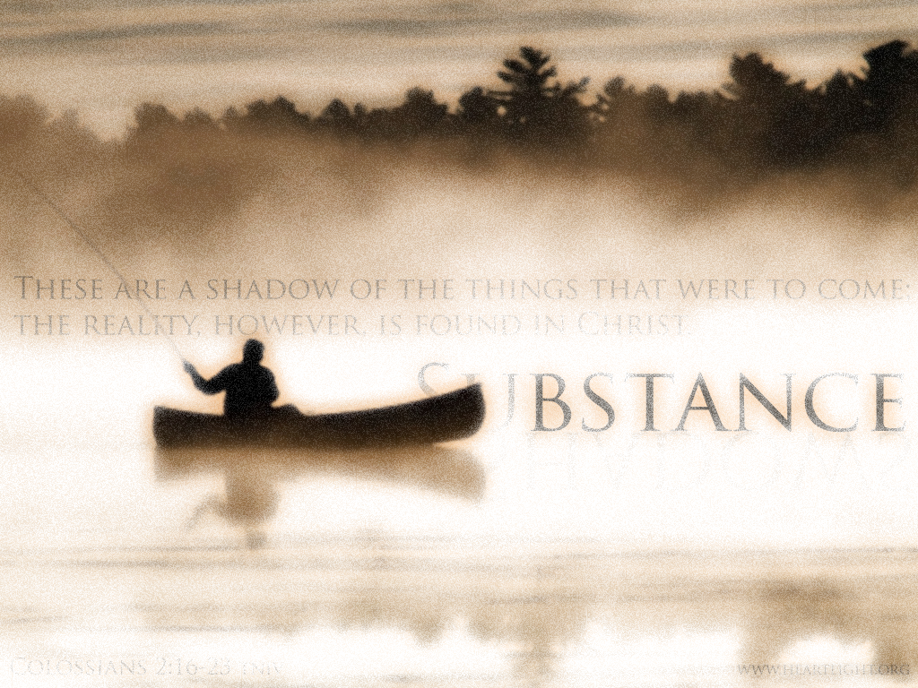
Shadows and substance
Colossians 2:16-17

Slide 2
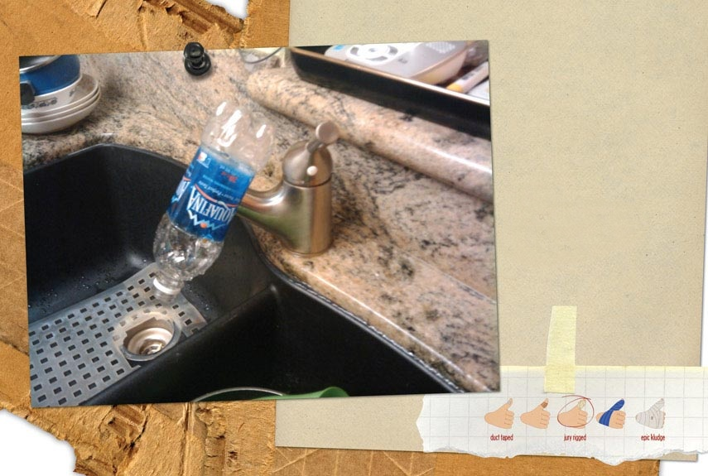
Shadows and substance
Colossians 2:16-17

Slide 3
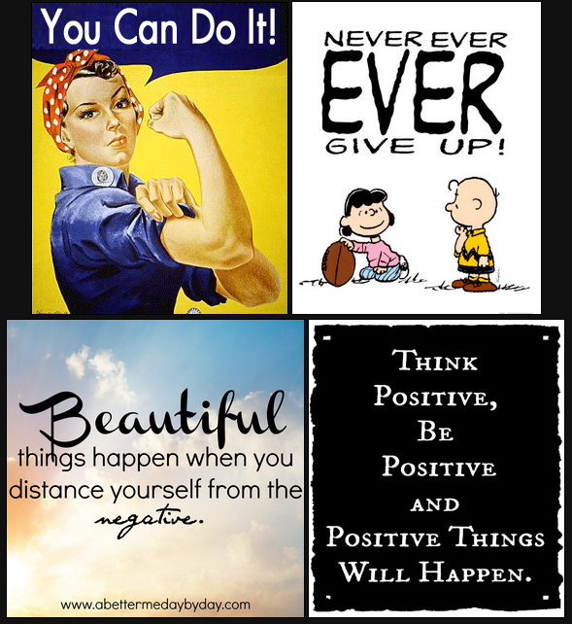
Shadows and substance
Colossians 2:16-17

Slide 4
Shadows and substance
Colossians 2:16-17
Paul’s warnings
Let no-one judge you (based on) rituals/traditions because they are only shadows
Let no-one disqualify you (based on) human efforts because these depart from Christ

Slide 5
Shadows and substance
Colossians 2:16-17
Paul’s warnings
First warning: “Don’t let anyone judge you by what you eat or drink or with regard to a religious festival, a New Moon celebration or a Sabbath Day. These are a shadow of the things that were to come; the reality, however, is found in Christ” (v.16-17).

Slide 6
Shadows and substance
Colossians 2:16-17
The Bondage of condemnation “Don’t let anyone judge you”
See to it that no-one takes you captive… v.8

Slide 7
Shadows and substance
Colossians 2:16-17
The Bondage of condemnation “Don’t let anyone judge you”
Courtroom

Slide 8
Shadows and substance
Colossians 2:16-17
The Bondage of condemnation “Don’t let anyone judge you”
Courtroom
“Let us stop passing judgment on one another” Rom 14:13

Slide 9
Shadows and substance
Colossians 2:16-17
The Bondage of condemnation “Don’t let anyone judge you”
Courtroom
Justice must be done. “I have already passed judgment on the one who did this…” (1 Cor. 5:5)

Slide 10
Shadows and substance
Colossians 2:16-17
The Bondage of condemnation “Don’t let anyone judge you”
Courtroom
Justice must be done.
Necessary accountability

Slide 11
Shadows and substance
Colossians 2:16-17
The Bondage of condemnation “Don’t let anyone judge you”
Courtroom
Justice must be done.
Necessary accountability
God’s analysis - I will come near to you for judgment. I will be quick to testify against sorcerers, adulterers and perjurers, against those who defraud labourers of their wages, who oppress the widows and the fatherless, and deprive aliens of justice, but do not fear me” (Mal 3:5).

Slide 12
Shadows and substance
Colossians 2:16-17
The Bondage of condemnation “Don’t let anyone judge you”
Courtroom
Justice must be done.
Necessary accountability
God’s analysis
Judgment of Pharisees and Jesus: “Do not judge at all if you judge the way the Pharisees do. If you do judge people this way, then you will be judged with the same severity.”

Slide 13
Shadows and substance
Colossians 2:16-17
The Bondage of condemnation
Ritualism – things forbidden
Clean/unclean food - Leviticus 11
Sabbath observance – Leviticus 23
Offerings calendar – Numbers 28

Slide 14
Shadows and substance
Colossians 2:16-17
The Bondage of condemnation
Ritualism – things forbidden
Paul’s self discipline – Philippians 3

Slide 15
Shadows and substance
Colossians 2:16-17
The Bondage of condemnation
Ritualism – things forbidden
Paul’s self discipline – Philippians 3
Peter’s vision – Acts 10 “Do not call anything impure that God has made clean” (v.15)

Slide 16
Shadows and substance
Colossians 2:16-17
The Bondage of condemnation
Ritualism – things forbidden
Paul’s self discipline – Philippians 3
Peter’s vision – Acts 10
Weaker brother – “Accept him whose faith is weak, without passing judgment on disputable matters” (Rom.14:1) + 1 Cor. 8:8 “food does not bring us near to God.”

Slide 17
Shadows and substance
Colossians 2:16-17
The Bondage of condemnation
Ritualism – things forbidden
To impose dietary restrictions is WRONG!

Slide 18
Shadows and substance
Colossians 2:16-17
The Bondage of condemnation
Ritualism - things forbidden
- things required – see 1 Chron. 23:31

Slide 19
Shadows and substance
Colossians 2:16-17
The Bondage of condemnation
Ritualism - things forbidden
- things required – see 1 Chron. 23:31
- celibacy of priesthood

Slide 20
Shadows and substance
Colossians 2:16-17
The Bondage of condemnation
Ritualism - things forbidden
- things required – see 1 Chron. 23:31
- celibacy of priesthood
- Christian Sabbatarianism

Slide 21
Shadows and substance
Colossians 2:16-17
The Bondage of condemnation
Ritualism - things forbidden
- things required – see 1 Chron. 23:31
- celibacy of priesthood
- Christian Sabbatarianism
- God-given therefore still required? – see NT!

Slide 22
Shadows and substance
Colossians 2:16-17
The Bondage of condemnation
Ritualism - things forbidden
- things required – see 1 Chron. 23:31
- celibacy of priesthood
- Christian Sabbatarianism
- God-given therefore still required? – see NT!
- Multi-cultural society

Slide 23
Shadows and substance
Colossians 2:16-17
The Bondage of condemnation
Ritualism - things forbidden
Shadows and substance

Slide 24
Shadows and substance
Colossians 2:16-17
The Bondage of condemnation
Ritualism - things forbidden
Shadows and substance
Shadows:

Slide 25
Shadows and substance
Colossians 2:16-17
The Bondage of condemnation
Ritualism - things forbidden
Shadows and substance
Shadows:
The tabernacle

Slide 26
Shadows and substance
Colossians 2:16-17
The Bondage of condemnation
Ritualism - things forbidden
Shadows and substance
Shadows:
The tabernacle
The ark

Slide 27
Shadows and substance
Colossians 2:16-17
The Bondage of condemnation
Ritualism - things forbidden
Shadows and substance
Shadows:
The tabernacle
The ark
The sacrifices

Slide 28
Shadows and substance
Colossians 2:16-17
The Bondage of condemnation
Ritualism - things forbidden
Shadows and substance
Shadows:
The tabernacle
The ark
The sacrifices
The priesthood

Slide 29
Shadows and substance
Colossians 2:16-17
The Bondage of condemnation
Ritualism - things forbidden
Shadows and substance
Shadows:
The tabernacle
The ark
The sacrifices
The priesthood
The temple

Slide 30
Shadows and substance
Colossians 2:16-17
The Bondage of condemnation
Ritualism - things forbidden
Shadows and substance
Shadows:
The tabernacle
The ark
The sacrifices
The priesthood
The temple
The Promised Land itself

Slide 31
Shadows and substance
Colossians 2:16-17
The Bondage of condemnation
Ritualism - things forbidden
Shadows and substance
Shadows:
Our religious shadows?

Slide 32
Shadows and substance
Colossians 2:16-17
The Bondage of condemnation
Ritualism - things forbidden
Shadows and substance
Shadows:
Our religious shadows? – Shadows lack detail

Slide 33
Shadows and substance
Colossians 2:16-17
The Bondage of condemnation
Ritualism - things forbidden
Shadows and substance
Shadows:
Our religious shadows?
Rituals

Slide 34
Shadows and substance
Colossians 2:16-17
The Bondage of condemnation
Ritualism - things forbidden
Shadows and substance
Shadows:
Our religious shadows?
Rituals
Sentimentalism

Slide 35
Shadows and substance
Colossians 2:16-17
The Bondage of condemnation
Ritualism - things forbidden
Shadows and substance
Shadows
Substance – Christ has done everything necessary!

Slide 36
Shadows and substance
Colossians 2:16-17
The Bondage of condemnation
Ritualism - things forbidden
Shadows and substance
Shadows
Substance – Christ has done everything necessary!
Determine the difference?

Slide 37
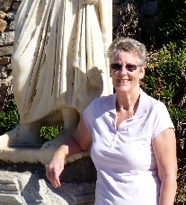
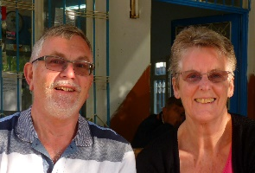
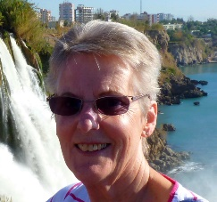
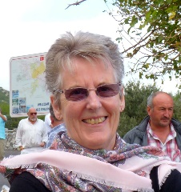
Shadows and substance
Colossians 2:16-17
The Bondage of condemnation
Ritualism - things forbidden
Shadows and substance
Shadows
Substance – Christ has done everything necessary!
Determine the difference?
Photos

Slide 38
Shadows and substance
Colossians 2:16-17
The Bondage of condemnation
Ritualism - things forbidden
Shadows and substance
Shadows
Substance – Christ has done everything necessary!
Determine the difference?
Photos
Escapism

Slide 39
Shadows and substance
Colossians 2:16-17
The Bondage of condemnation
Ritualism - things forbidden
Shadows and substance
Shadows
Substance – Christ has done everything necessary!
Determine the difference?
Don’t substitute substance for shadow!

Slide 40
Shadows and substance
Colossians 2:16-17
The Bondage of condemnation
Ritualism - things forbidden
Shadows and substance
Shadows
Substance – Christ has done everything necessary!
Determine the difference?
Don’t substitute substance for shadow!
Isaiah’s warning

Slide 41
Shadows and substance
Colossians 2:16-17
The Bondage of condemnation
Ritualism - things forbidden
Shadows and substance
Stop bringing meaningless offerings! Your incense is detestable to me. New Moons, Sabbaths and convocations – I cannot bear your worthless assemblies. Your New Moon feasts and your appointed festivals I hate with all my being. They have become a burden to me; I am weary of bearing them. When you spread out your hands in prayer, I hide my eyes from you; even when you offer many prayers, I am not listening. Your hands are full of blood! Wash and make yourselves clean. Take your evil deeds out of my sight; stop doing wrong. Learn to do right; seek justice. Defend the oppressed. Take up the cause of the fatherless; plead the case of the widow. ‘Come now, let us settle the matter,’ says the Lord. ‘Though your sins are like scarlet, they shall be as white as snow; though they are red as crimson, they shall be like wool. If you are willing and obedient, you will eat the good things of the land; but if you resist and rebel, you will be devoured by the sword.’ For the mouth of the Lord has spoken.

Slide 42
Shadows and substance
Colossians 2:16-17
The Bondage of condemnation
Ritualism - things forbidden
Shadows and substance
Fix eyes on Jesus

Slide 43
Shadows and substance
Colossians 2:16-17
The Bondage of condemnation
Ritualism - things forbidden
Shadows and substance
Fix eyes on Jesus
Not DIY but DONE!

